Slide 1

Vel Tech Rangarajan Dr. Sagunthala R&D Institute of Science and Technology
School of Computing
Department of Computer Science and Engineering(Cyber Security)
10211CS224 / FULL STACK APPLICATION DEVELOPMENT (JAVA)
PROJECT REVIEW : MILESTONE PROJECT – 2
Date: 24-04-2026
DYNAMIC ONLINE EXAMINATION & RESULT PROCESSING SYSTEM
SDG 4 – Quality Education
Presented By:
HARITHA .D – VTU24553 – 23UESS0022.
Courses Handling Faculty:
Dr. SHAHUL HAMEED C
ASSISTANT PROFESSOR

Slide 2
INTRODUCTION
1
In many educational institutions, conducting examinations and processing results manually requires significant time and effort.
Traditional examination systems involve preparing question papers, evaluating answer sheets, and publishing results manually.
These methods can lead to delays and human errors in result calculation.
The Dynamic Online Examination & Result Processing System provides a digital platform to conduct examinations online.
Students can attend exams through a web interface, and the system automatically evaluates their answers.
The system improves efficiency, reduces manual work, and ensures accurate result generation.
By using database-driven web technologies, the application demonstrates a practical implementation of modern educational systems.
This project contributes to SDG 4 – Quality Education by promoting digital learning infrastructure and improving transparency, accessibility, and efficiency in academic evaluation systems.
2
3
4
5
6
7
8
9

Slide 3
PROBLEM STATEMENT
1
2
In many institutions, the examination process is still performed manually or using partially automated systems.
This often leads to delays in result processing and difficulty in managing exam data.
Manual evaluation of answer sheets requires significant time and effort from teachers and administrators.
Handling a large number of students and exam records may lead to data management issues.
Traditional systems may also increase the chances of human errors during evaluation.
Students often experience delays in receiving their examination results.
Administrators face challenges in organizing and maintaining exam-related information efficiently.
Therefore, an automated online examination system is required to conduct exams and generate results quickly and accurately.
3
4
5
6
7
8
9

Slide 4
OBJECTIVE(S)
1
• To design and develop a web-based Online Examination System that allows students to attend exams digitally.
• To implement an automated result processing mechanism that evaluates answers instantly and generates accurate results.
2
3
4
5
6
7
8
9

Slide 5
PROPOSED SYSTEM
1
2
A web-based examination portal developed using PHP, JavaScript, and MySQL.
Supports both MCQ questions and coding-based programming assessments.
Admin can create exams, add questions, and schedule exam timings.
Students can register, log in, and attempt exams within the allowed time.
Coding questions are evaluated automatically using predefined test cases.
The system calculates scores and generates results automatically.
Admin can manage student records, exams, and result publication.
The system improves efficiency and eliminates manual evaluation processes.
3
4
5
6
7
8
9

Slide 6
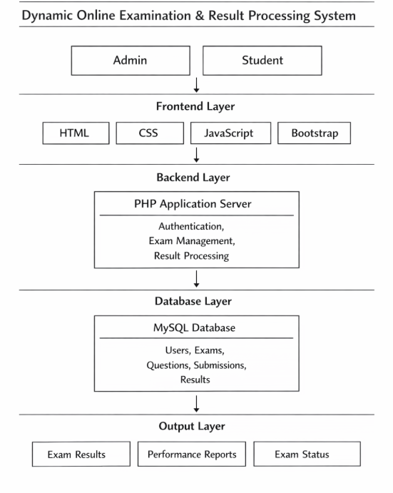
PROPOSED SYSTEM ARCHITECTURE
1
2
3
4
5
6
7
8
9

Slide 7
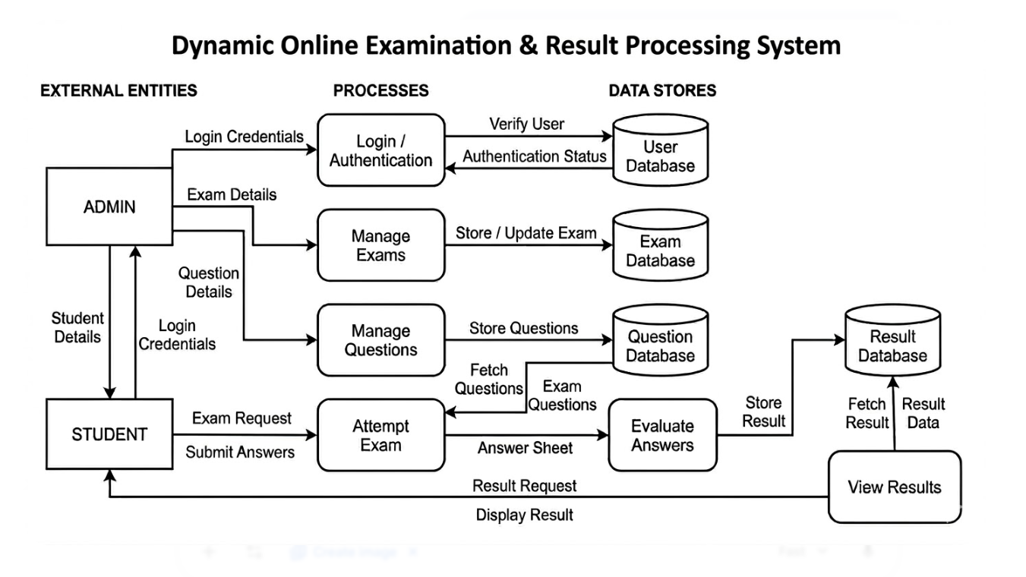
WORKFLOW
1
2
3
4
5
6
7
8
9

Slide 8
TECHNOLOGIES USED
1
2
Frontend: HTML5, CSS3, JavaScript, Bootstrap
Backend: PHP
Database: MySQL
Tools: XAMPP (Apache + MySQL), VS Code
Hardware/Software Requirements: Windows OS, Web Browser, XAMPP Server, Minimum 4GB RAM
3
4
5
6
7
8
9

Slide 9
MODULE DESCRIPTION
1
Module 1: User Management Handles student and admin registration, login, and authentication using secure sessions.
Module 2: Assessment Management Allows administrators to create exams, add MCQ and coding questions, and configure exam settings.
Module 3: Exam Execution Students attempt exams through an interface with timer support and question navigation.
Module 4: Code Evaluation Engine Compiles and executes student code in languages such as Java, Python, C, and C++ against test cases.
Module 5: Result Processing & Analytics Automatically calculates scores and generates detailed result reports for students.
2
3
4
5
6
7
8
9

Slide 10

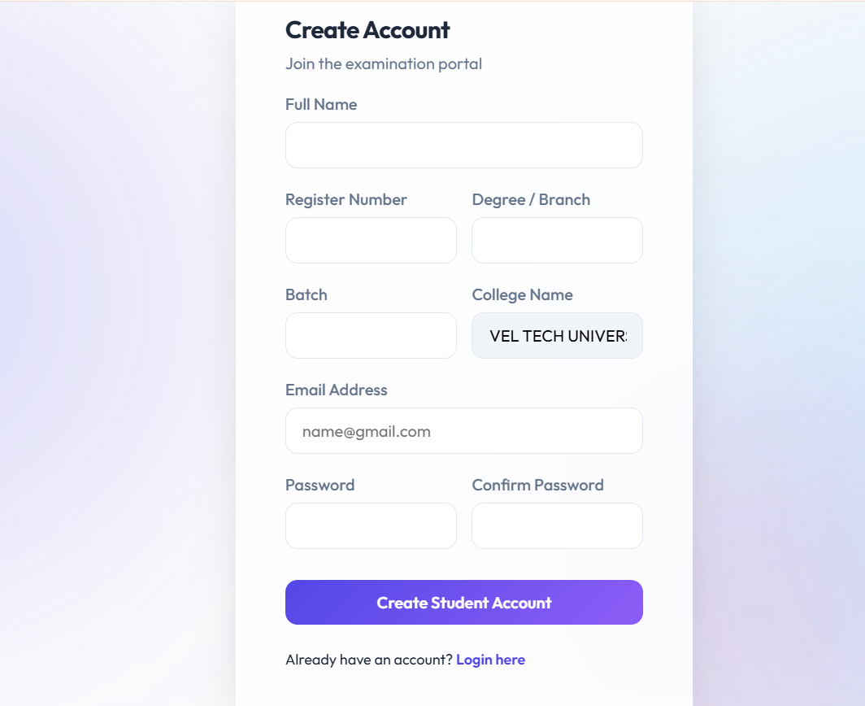
IMPLEMENTATION SCREENSHOTS
1
2
3
4
5
6
7
8
9
Login Page & Create Account Page This page allows users to securely log into the system using their credentials. New users can create an account by registering their details to access the online examination system.

Slide 11
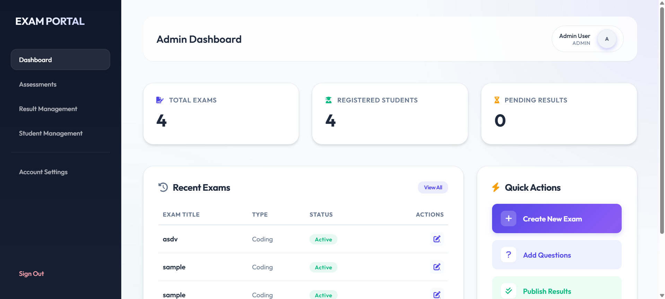
IMPLEMENTATION SCREENSHOTS
1
2
3
4
5
6
7
8(A)
9
Admin Dashboard The admin dashboard provides a centralized interface for administrators to monitor and control the system. From here, the admin can manage exams, questions, and view system activities.

Slide 12
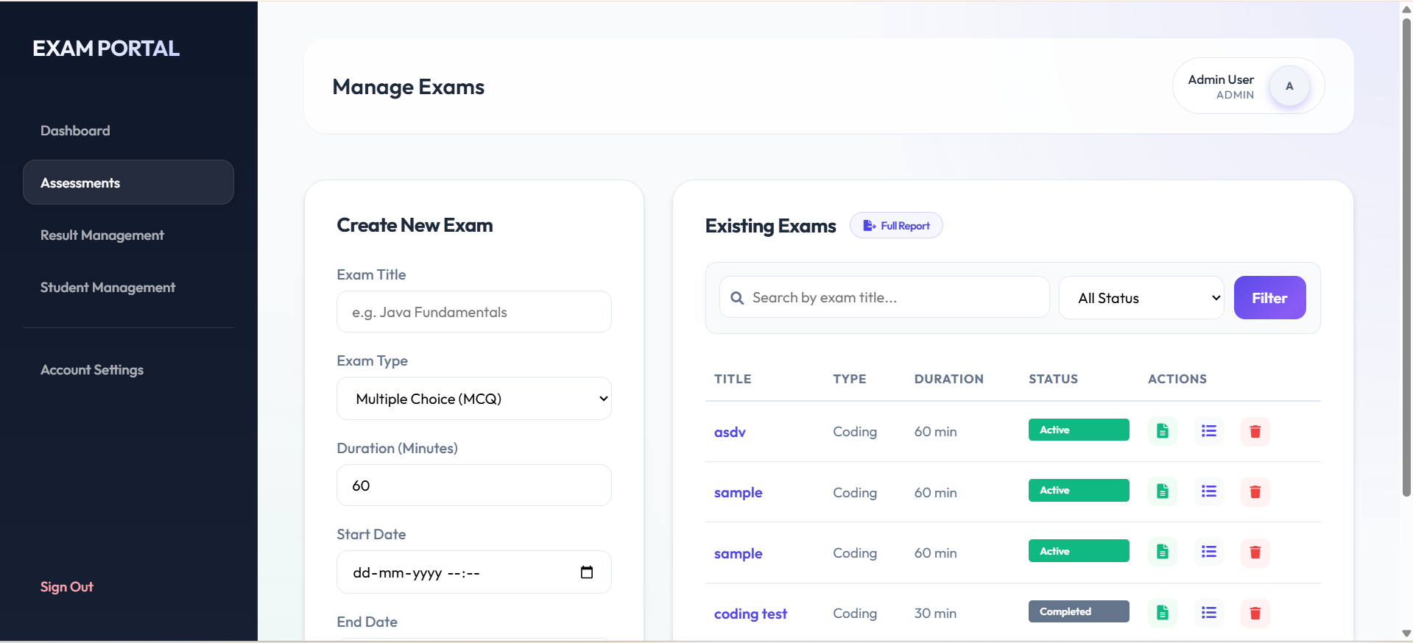
IMPLEMENTATION SCREENSHOTS
1
2
3
4
5
6
7
8(B)
9
Assessment Management This module enables the admin to create, update, and manage examinations and question sets. It helps organize assessments and ensures exams are properly scheduled and maintained.

Slide 13
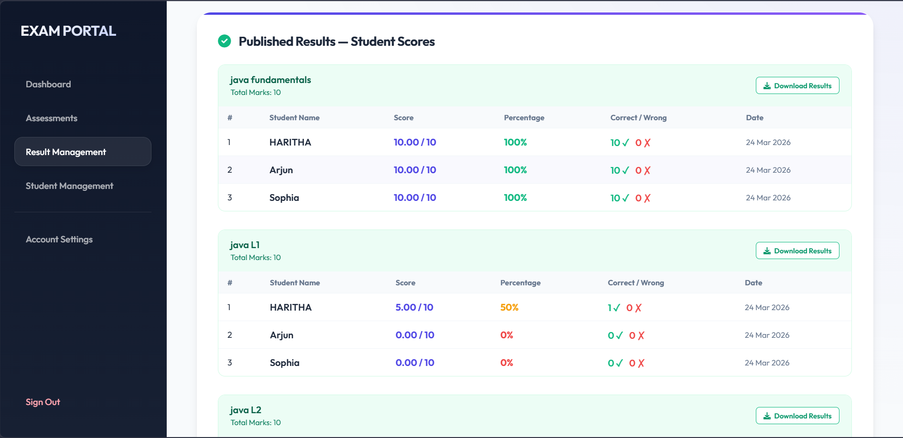
IMPLEMENTATION SCREENSHOTS
1
2
3
4
5
6
7
8(C)
9
Result Management This module enables the admin to generate results report of students

Slide 14
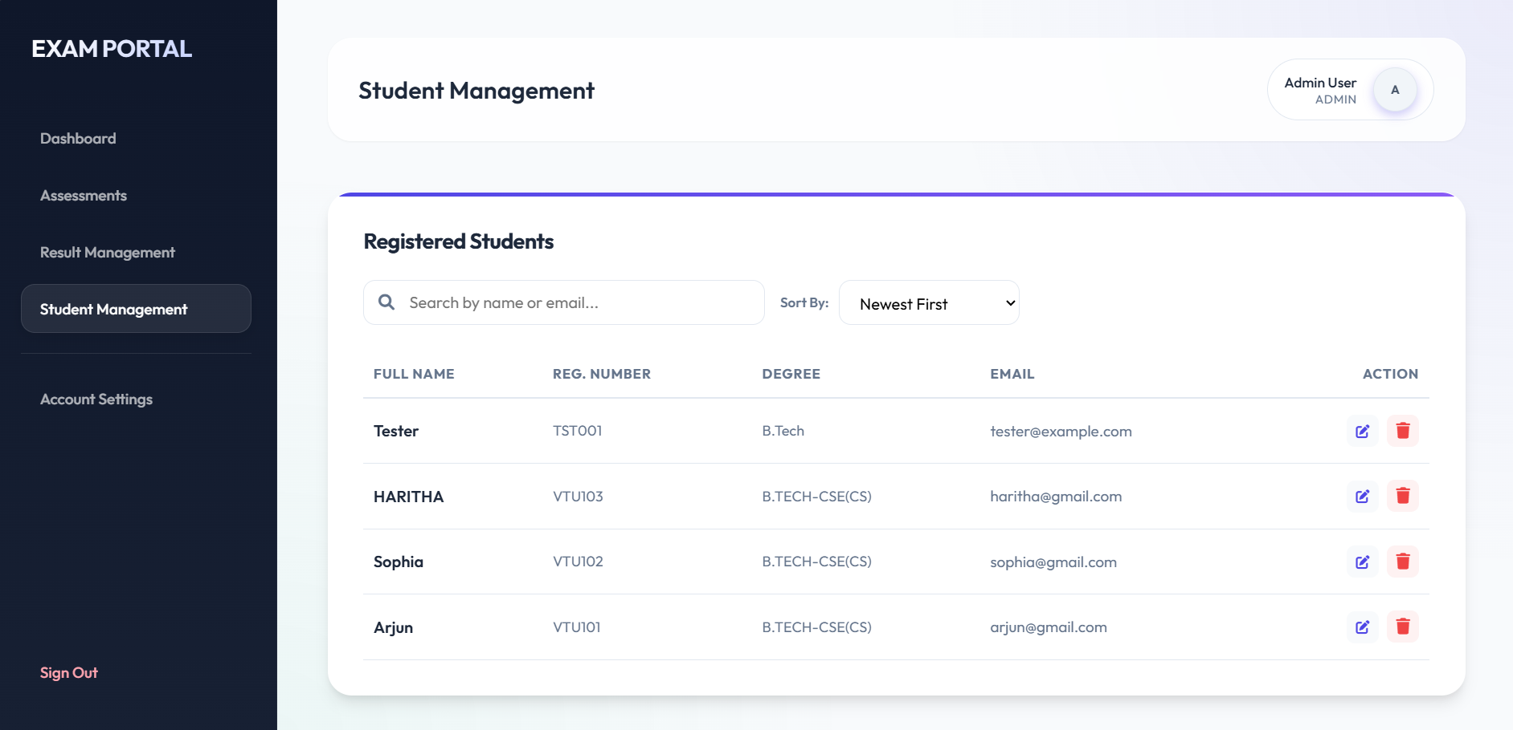
IMPLEMENTATION SCREENSHOTS
1
2
3
4
5
6
7
8(D)
9
Student Management This module enables the admin to manage students and their credentials

Slide 15
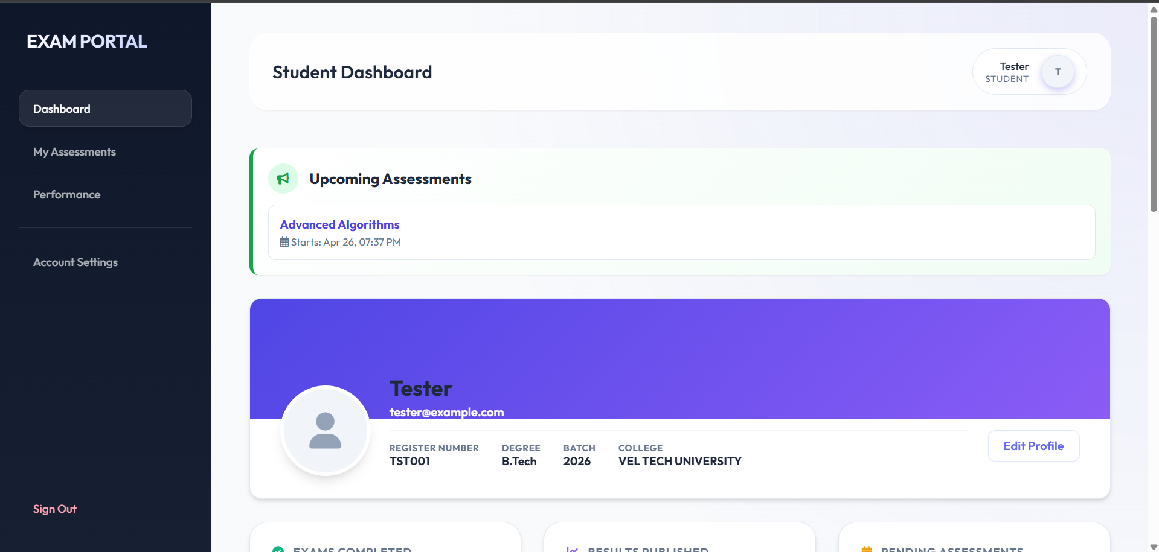
IMPLEMENTATION SCREENSHOTS
1
2
3
4
5
6
7
8(E)
9
Student Dashboard The student dashboard allows students to view available exams and participate in assessments. It also provides access to exam results and other exam-related information.

Slide 16
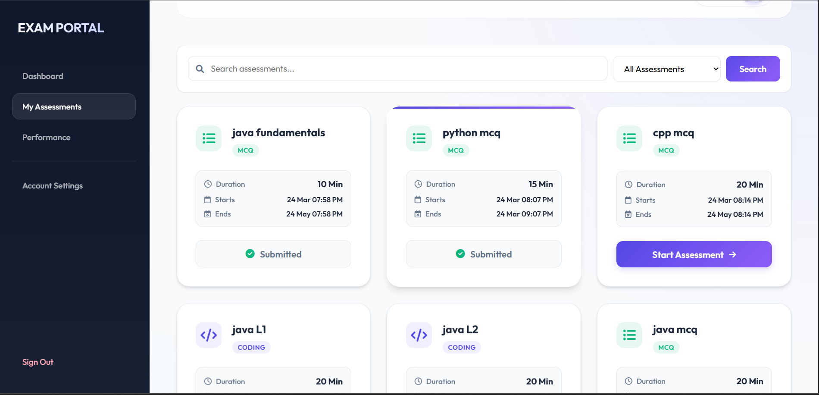
IMPLEMENTATION SCREENSHOTS
1
2
3
4
5
6
7
8(F)
9
My Assessment This Tab allows students to view available exams and participate in assessments. It also provides access to exam results and other exam-related information.

Slide 17
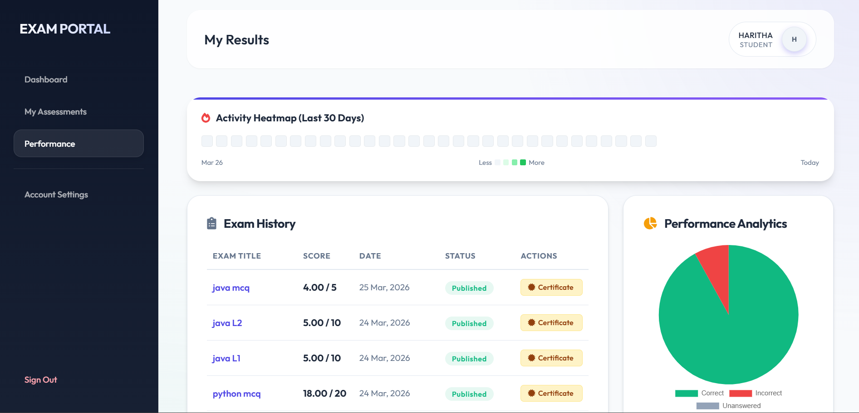
IMPLEMENTATION SCREENSHOTS
1
2
3
4
5
6
7
8(G)
9
Performance This allows students to view and download their certificates for the exam and heat map is available to track their progress.

Slide 18

IMPLEMENTATION SCREENSHOTS
1
2
3
4
5
6
7
8(G)
9

Slide 19
ADVANTAGES & LIMITATIONS
1
Advantages
• Automates the entire examination and evaluation process • Supports both MCQ and coding-based assessments • Provides instant result generation • Reduces manual work and human errors • Scalable system suitable for educational institutions
Limitations
• Requires stable internet connectivity • Security measures must be implemented to prevent misuse • System performance depends on server capacity
2
3
4
5
6
7
8
9

Slide 20
Thank you

